Slide 1
INVESTMENT CASE STUDY SUBMISSION
Sunil Appanaboyina

Slide 2
Abstract
Goal of this study is to understand the global trends in startup investments so that investment decisions can be taken effectively
The objective is to identify the best sectors, countries, and a suitable investment type for making investments
The overall strategy is to invest where others are investing, implying that the best sectors and countries are the ones where most investments are happening
Constraints
To invest only between 5 to 15 million USD per round of investment
To invest only in English-speaking countries
Data analysis done in this study
Investment type analysis
Country analysis
Sector analysis

Slide 3
Problem Solving Methodology
Business objective
definition
& understanding
Data understanding & preparation
Cleaning & manipulating data
Data analysis
Investment type analysis
Country analysis
Sector analysis
Presentation of results

Slide 4
Investment Type Analysis
GOAL: To understand investments in venture, seed/angel, private equity categories so that Spark Funds can decide which type is best suited for its strategy of investing only between 5 to 15 million USD per round of investment
Calculate the average investment amount for each of the four funding types (venture, angel, seed, and private equity)
RESULT: Based on the average investment amount calculated, venture investment type is the most suitable for Spark Funds

Slide 5
Country Analysis
GOAL: Understand which countries have had the most investments in “venture type funding” in the past. Part of a broader strategy to invest where most investments are occurring
Invest only in English-speaking countries because of the ease of communication with the companies it would invest in
A country is considered to be English speaking only if English is one of the official languages in that country
Analyzed the top nine countries which have received the highest total “venture type funding” and among them identified the top 3 English speaking countries
RESULT: USA, GBR (Great Britain), IND (India)

Slide 6
Sector Analysis
GOAL: Understand the distribution of investments across the eight main sectors and identify the top 3 sectors with the most “venture funding type investment” between 5-15 million in USA, GBR & IND
Extracted the primary sector from each category list from the category_list column and used a mapping file to map each primary sector to one of the eight main sectors
RESULT:
Sector based on count of investments | USA | GBR | IND
Top | Others | Others | Others
Second best | Social,Finance,Analytics,Advertising | Social,Finance,Analytics,Advertising | Social,Finance,Analytics,Advertising
Third best | Cleantech / Semiconductors | Cleantech / Semiconductors | News,Search and Messaging

Slide 7
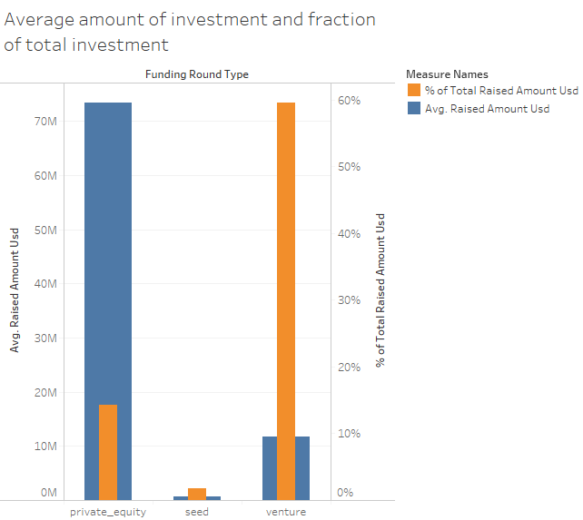
Results

Slide 8
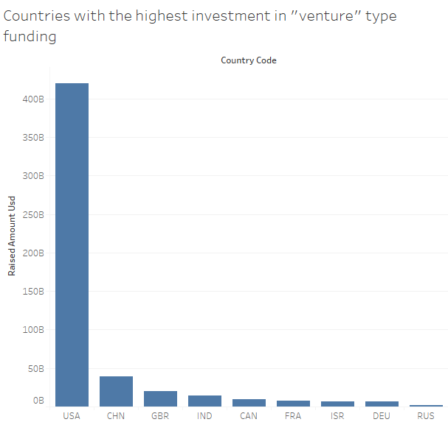
Results

Slide 9
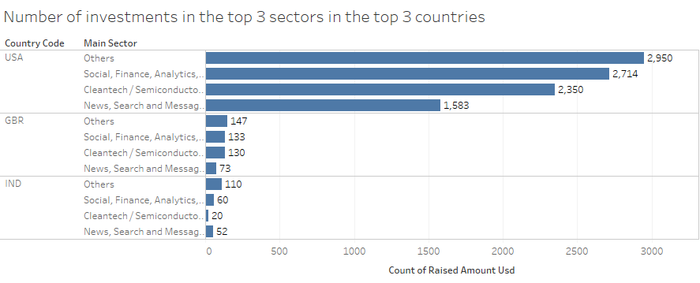
Results

Slide 10
Conclusions
Spark Funds should invest in venture type funds in USA, Great Britain and India in the below mentioned sectors
USA
Others
Social, Finance, Analytics, Advertising
Cleantech & Semiconductors
Great Britain
Others
Social, Finance, Analytics, Advertising
Cleantech & Semiconductors
India
Others
Social, Finance, Analytics, Advertising
News, Search and Messaging

